Slide 1
Tasks explained
Picture Memory Task: Fractal-N-Back
Money Task: MID
Go/No Go Task: Stop Signal

Slide 2
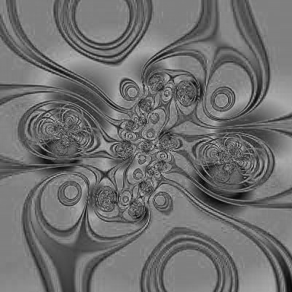

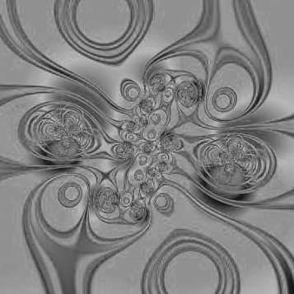

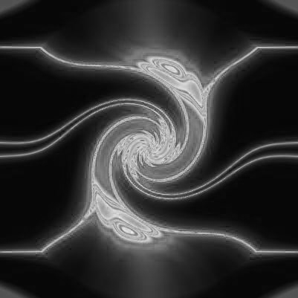
Zero Back
Respond with your index finger whenever you see the Target image.
Respond your middle finger for each image that is not the Target image
Target Image
Which buttons would you press?
Notes:
In Picture-back task, you will be shown one picture at a time. You want to respond to all the pictures you have seen according to a rule that I will describe in the following.
ZeroBack: When seeing the target image, press 6 (index finger), otherwise, press 7 (middle finger). Regardless of being practice or in the scanner, the target image is always the one shown here. So remember that image now. Also, you will not see this target image in other conditions (OneBack and TwoBack), so you will not be confused by this.

Slide 3

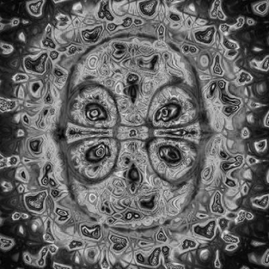


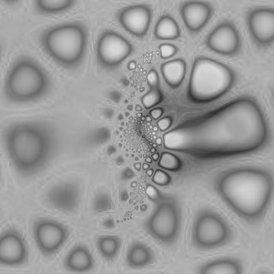

One Back
Respond with your index finger whenever one image matches the image immediately preceeding it.
Respond with your middle finger for all other images.
Which button would you press?
1
2
3
4
5
Match?
Yes
No
No
Yes
6
7
8
9
10
Notes:
OneBack: match one picture before the current picture. If the current picture is the same as the one before it, press 6 (index finger), otherwise, press 7. Since the first one has nothing before it to match, press 7.

Slide 4





Two Back
Press your index finger whenever one image matches an image that appeared two images previously.
Press your middle finger for all other images.
Which button would you press?
1
Match?
2
3
4
5
Yes
Yes
No
6
7
8
9
10
Notes:
TwoBack: match two pictures before the current picture. If the current matches two pictures before it, press 6 (index finger), otherwise, press 7 (middle finger). For instance, picture 3 matches picture 1, you need to respond by pressing 6. Similarly, 4 matches 2, you need to respond with 6. 5 does not match with 3, so you need to respond by pressing 7.
Since neither picture 1 nor 2 has 2 pictures before it to match, press 7 for these two pictures.
Note that picture 9 and picture 10 are matching, but we are doing TwoBack, so 10 needs to match with 8, not 9.
To prevent confusion, at the beginning of each mini-block, we are going to prompt you with the condition/rule you need to follow to respond to the picture. Also, in between each picture, we are going to show a number on the blank screen, to remind you what condition you are currently on. So if “0”, you are doing ZeroBack; if “1”, you are doing OneBack; or if “2”, you are doing TwoBack.

Slide 5

Picture Memory Run Flow
0
0
0
1
1
1
2
2
2
REST

Slide 6
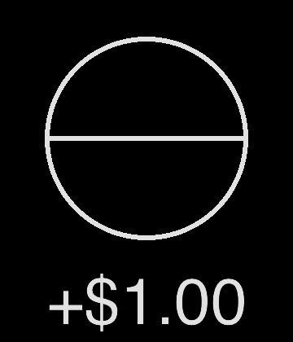


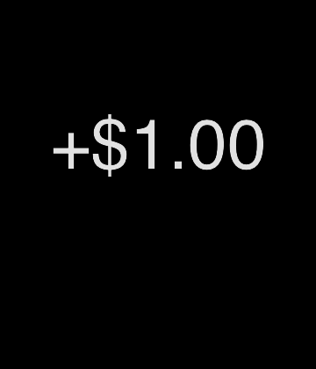

Money Task: Overview
How much money you can win.
Wait …
Quick!
Respond!
Win Money!
Notes:
The point of this task is to respond as quickly as possible to gain money or avoid losing money. You are going to see 4 items in the sequence presented above: 1). How much money you are going to win/lose; 2). Waiting / fixation period; 3). Target triangle which you want to respond to by pressing the button; 4). Feedback telling you how much you win/lose.
Picture: Finger pressing button: http://www.designofsignage.com/application/symbol/hands/image/600x600/hand-press-button-4.jpg (June 17 2013)

Slide 7
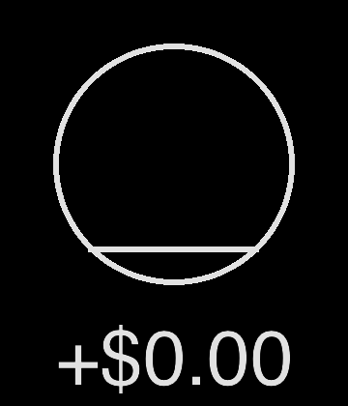

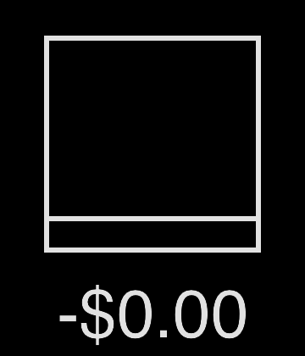
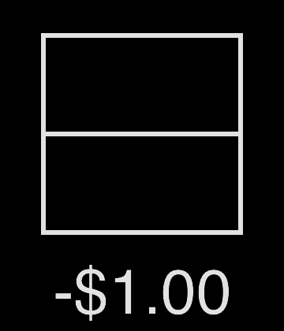
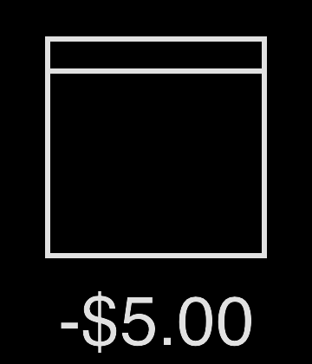
Money Task: Conditions
Winning Conditions
Losing Conditions
Notes:
There are 6 possible conditions. Circles mean you are going to win a certain amount of money; squares mean you are going to lose a certain amount of money. It all depends on how fast you can press the button.
Some may think it is not necessary to respond to the zero dollar conditions because they think they are not gaining anything from it. I recommend that if you want to maximize the money you can gain, you should respond to all the conditions; honestly, the computer program will not favor you if you skip the zero dollar conditions.
Next, we are going to explain how you can win/lose money in detail.

Slide 8

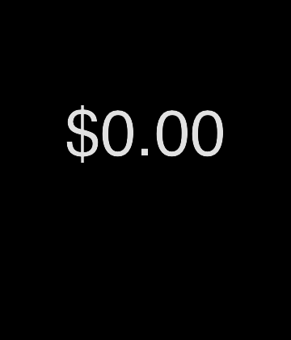
Money Task: Winning
Win Money
Responding too early
or too late
Win Nothing
Notes:
1). When you see a winning money prompt/cue (always a circle), if you press the button quickly enough while the triangle is still on the screen, you will win money;
2). However, if you respond before the triangle shows up or responded too late (after the triangle already disappeared), then you are not going to win any money. So try not to get ahead of yourself, while keep alert when the triangle shows up.

Slide 9
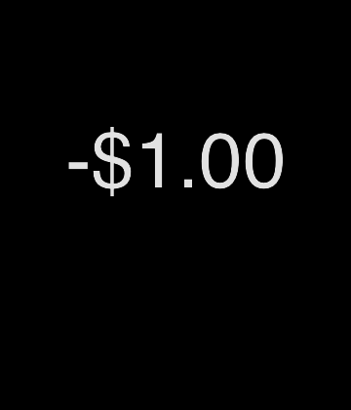
Money Task: Losing
Lose Nothing
Responding too early
or too late
Lose Money
Notes:
1). When you see a money losing prompt (always a square), if you press the button fast enough when the triangle is still on the screen, you avoid losing money.
2). However, if you press too early (before the triangle shows up) or after the triangle has disappeared, you will lose money.
All in all, respond as quickly as possible when the triangle shows up is the key to win the money.

Slide 10

Go/No Go Task: Go
Press Left Key
Press Right Key
Notes:
You will see only 2 items: the empty circle, and inside the circle, the arrow. If you see the left arrow, you press your left key (index finger); if you see the right arrow, you press your right key (middle finger). Try to respond as soon as you see the arrow.

Slide 11

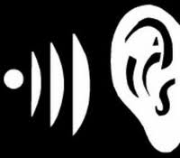
Go/No Go Task: Stop
BEEP!
Don’t press any key
Notes:
There are times when, immediately after the arrow, you are going to hear a loud beep. When you hear the beep, try not to respond. Often times you may fail, and that is actually what the computer program wants: it wants to make you fail 50% time, so that only 50% time you will successfully stop yourself, whereas the other 50% of the time, you will press on the beep (that is, you heard the beep and you tried to stop yourself, but you finger wouldn't listen and pressed the button anyway). That’s okay, and don’t get frustrated.
Don’t wait for the beep! Respond quickly. There is no way to predict when the beep is going to come. Even if you successfully predicted the beep once, the program is going to adjust itself so you cannot predict it anymore. So even if you try to predict the beep, you will still get 50% right when hearing the beep.
Picture: stop sign: http://upload.wikimedia.org/wikipedia/en/6/69/Stop_sign(standard).svg (June 17 2013)
Ear and sound: https://encrypted-tbn0.gstatic.com/images?q=tbn:ANd9GcSFaLNnhq84BnI10IQbiqDWlSkaocIEQ6Y_2MAoo0glHx9eaA_q3A (June 17 2013)

Slide 12
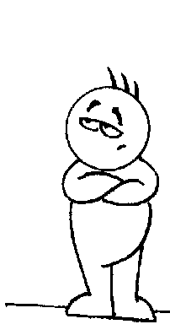
Go/No Go Task: Don’t wait for the Beep
Press the key now!
Don’t wait for the beep.
Notes:
Don’t wait for the beep! Respond as soon as possible. There is no way to predict when the beep is going to come.
Picture:
waiting: http://3.bp.blogspot.com/-TdNwAvQ68rE/Teu93SIwvnI/AAAAAAAABKo/ENEoRd84NFc/s1600/wait1.gif (June 17 2013)

